Slide 1

Hazardous Wastes (Management and Handling) Rules, 1989
Information Security Fundamentals | Environmental Laws and Regulation
Course: Information Security Fundamentals | Chapter: Environmental Laws and Regulation | Program: Bachelor of Engineering
DISCOVER · LEARN · EMPOWER
Notes:
Welcome everyone to this advanced session on Environmental Laws. Today we focus specifically on the Hazardous Wastes Rules of 1989, a critical framework for managing dangerous materials. As future engineers, understanding these regulations is not just about compliance but about securing our planet through sustainable design.

Slide 2
Course Outcomes
SLIDE 2 / 14
Course Outcome
CO | BT LEVEL | DESCRIPTION
CO1 | BT4 | Recall, analyze and respond on fundamental environmental principles, such as ecological relationships and conservation strategies
CO2 | BT4 | Understand and analyze the interconnections between human activities and environmental impacts across different ecosystems
CO3 | BT4 | Understand and analyze and apply environmental laws and policies to analyse and propose solutions for real-world environmental challenges.
CO4 | BT2 | Students will analyse data from environmental monitoring programs to assess trends and predict future impacts on ecosystems.
CO5 | BT6 | Interpret, elaborate and propose various tools, design and innovative strategies for sustainable development and environmental conservation initiatives in securing the planet.
Chandigarh University
2 / 14
Notes:
Our primary learning outcome for this lecture is CO5. This outcome requires you to not just read the rules, but to interpret them and propose innovative strategies for sustainable development. We will see how these rules directly enable environmental conservation initiatives.

Slide 3
Learning Objectives
SLIDE 3 / 14
Learning Outcomes
1
Analyze the specific scope and applicability of the 1989 Rules.
2
Evaluate the procedural requirements for hazardous waste disposal.
3
Critique the role of the Central Pollution Control Board.
4
Design strategies for compliant waste management in industrial settings.
5
Propose solutions for common pitfalls in hazardous waste handling.
Chandigarh University
3 / 14
Notes:
By the end of this lecture, you will be able to analyze the specific scope of these rules. You will evaluate disposal procedures and critique the regulatory body's role. Most importantly, you will design and propose solutions for real-world compliance challenges.

Slide 4
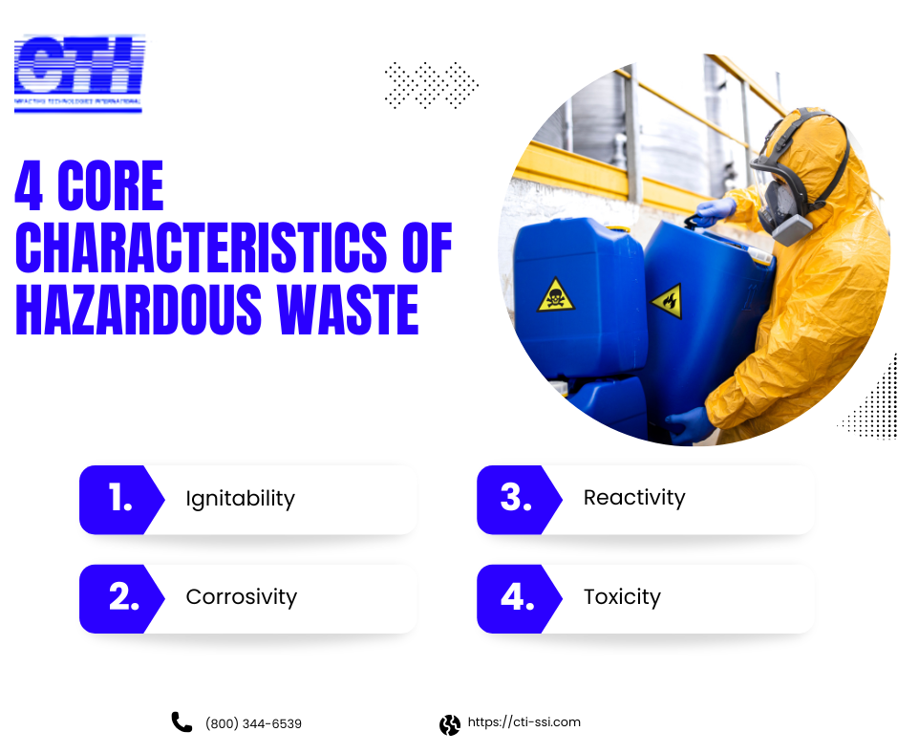
Lecture
SLIDE 4 / 14
Definition and Scope of Hazardous Waste
1
Hazardous waste is defined by specific physical or chemical properties.
2
The rules apply to waste listed in the Schedule of the Act.
3
Properties include ignitability, corrosivity, reactivity, and toxicity.
4
Any waste capable of causing harm to health or environment is covered.
5
The definition extends to waste generated during industrial processes.
6
Exclusions apply only to specific radioactive and nuclear wastes.
7
The rules mandate strict identification before any handling begins.
Characteristics of Hazardous Waste: Complete Guide 2025
Chandigarh University
4 / 14
Notes:
The 1989 Rules define hazardous waste based on specific properties like ignitability or toxicity. For example, a solvent with a flash point below 60°C is automatically classified as hazardous. This definition is the first step in the legal chain of custody for any industrial waste.

Slide 5
Lecture
SLIDE 5 / 14
Classification and Categorization of Waste
1
Waste is categorized into specific classes based on chemical nature.
2
Class 1 includes waste containing heavy metals like lead or mercury.
3
Class 2 covers organic solvents and petroleum by-products.
4
Class 3 involves reactive substances that explode or release gas.
5
Class 4 includes toxic substances that cause severe health issues.
6
Each class requires distinct handling protocols under the Rules.
7
Misclassification leads to severe legal penalties and environmental damage.
Chandigarh University
5 / 14
Notes:
The Rules categorize waste into four main classes to ensure proper handling. Class 1 typically involves heavy metals, while Class 2 covers organic solvents. If you misclassify a reactive substance as non-hazardous, you risk a catastrophic explosion, which is why strict categorization is vital.

Slide 6
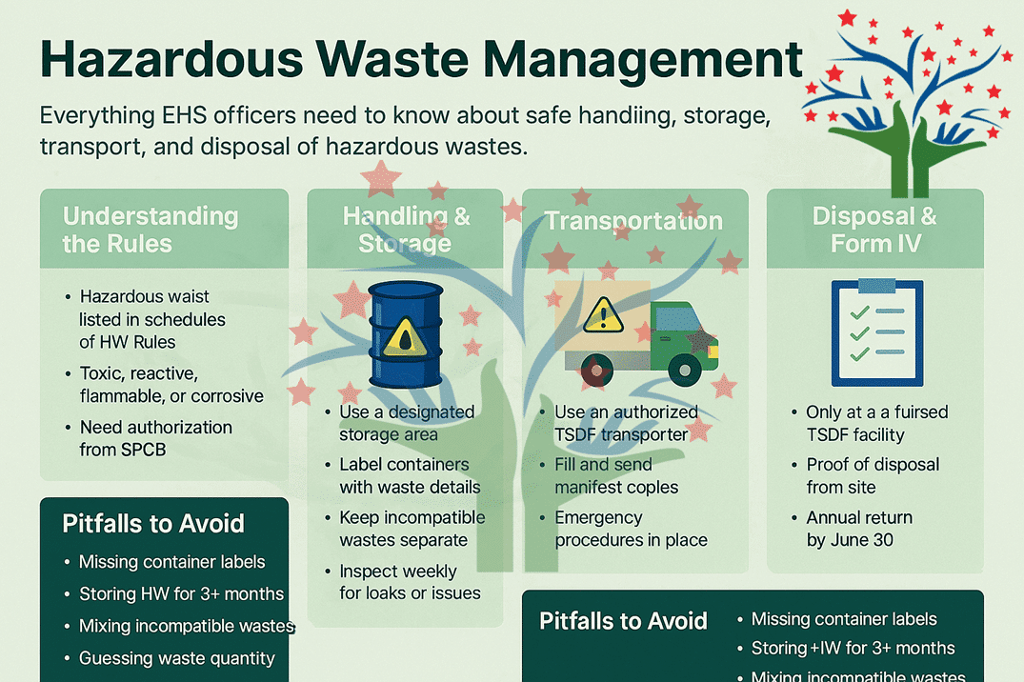
Lecture
SLIDE 6 / 14
Prohibitions on Import and Export
1
Import of hazardous waste is strictly prohibited without specific permission.
2
Export of hazardous waste requires prior consent from the CPCB.
3
The Rules prevent the transfer of waste to unregulated countries.
4
Import for recycling is allowed only under strict supervision.
5
Export for disposal is generally banned to protect national interests.
6
Violations result in immediate seizure of the consignment.
7
Customs authorities act as the first line of defense.
Hazardous Waste Management: A Guide from the Field - Perfect Pollucon LLP (source: www.ppsthane.com)
Chandigarh University
6 / 14
Notes:
The Rules strictly prohibit the import of hazardous waste to protect Indian ecosystems. Export is allowed only for recycling, not for disposal, and requires Central Pollution Control Board consent. This prevents India from becoming a dumping ground for foreign industrial waste.

Slide 7
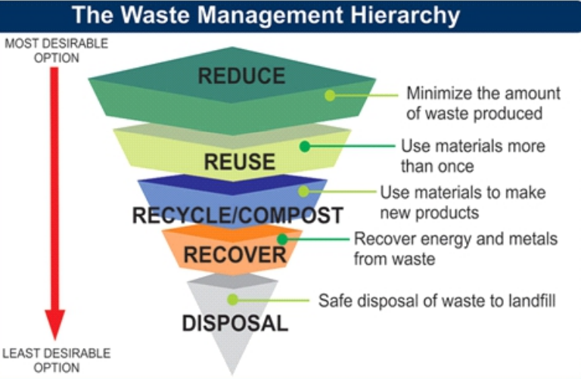
Lecture
SLIDE 7 / 14
Role of the Central Pollution Control Board
1
The CPCB formulates guidelines for hazardous waste management.
2
The Board grants consent for setting up disposal facilities.
3
CPCB monitors compliance through regular inspections and audits.
4
The Board maintains a national registry of hazardous waste generators.
5
It coordinates with state boards for enforcement actions.
6
The CPCB has the power to issue stop-work orders.
7
Regulatory oversight ensures uniform standards across all industries.
Managing Hazardous Waste (source: drishtiias.com)
Chandigarh University
7 / 14
Notes:
The Central Pollution Control Board is the regulatory backbone of these Rules. They grant consent for facilities and maintain a national registry of generators. Without their oversight, industries might bypass safety protocols, leading to uncontrolled pollution.

Slide 8
Lecture
SLIDE 8 / 14
Generator Responsibilities and Reporting
1
Generators must maintain a detailed register of all waste produced.
2
Annual returns must be submitted to the State Pollution Board.
3
Generators are liable for waste until it is properly disposed.
4
Transportation must be done by authorized carriers only.
5
Manifest system tracks waste from generation to final disposal.
6
Failure to report results in heavy fines and legal action.
7
Generators must ensure waste is treated before final disposal.
Chandigarh University
8 / 14
Notes:
Generators bear full responsibility for their waste from cradle to grave. They must maintain a register and submit annual returns to the State Board. The manifest system acts as a tracking tool, ensuring no waste is lost or dumped illegally during transportation.

Slide 9
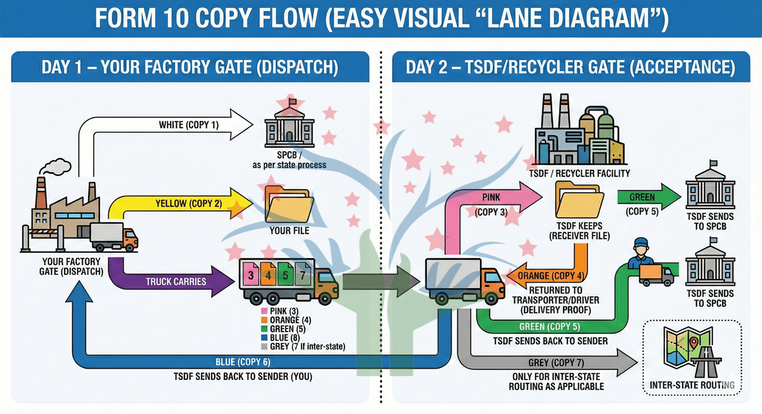
Lecture
SLIDE 9 / 14
Transportation and Manifest System
1
Transportation requires a specific manifest form for every consignment.
2
The manifest must accompany the waste throughout the journey.
3
Authorized carriers must have valid permits for hazardous transport.
4
The system ensures traceability from source to treatment plant.
5
Any deviation in the manifest triggers an immediate investigation.
6
Packaging must meet international safety standards for transport.
7
Drivers must be trained in emergency response procedures.
Source: www.ppsthane.com
Chandigarh University
9 / 14
Notes:
The manifest system is the backbone of safe transportation. Every consignment must have a manifest that travels with it, signed by the generator, carrier, and receiver. If a truck breaks down, this document allows authorities to immediately identify the hazardous contents and respond appropriately.

Slide 10
Lecture
SLIDE 10 / 14
Treatment and Disposal Facilities
1
Facilities must obtain prior consent before commencing operations.
2
Treatment methods must reduce toxicity to safe levels.
3
Disposal sites must be engineered to prevent soil contamination.
4
Incineration is used for organic hazardous waste reduction.
5
Landfilling is restricted to non-recyclable, treated residues only.
6
Facilities must have emergency containment systems in place.
7
Regular environmental monitoring is mandatory for all sites.
Chandigarh University
10 / 14
Notes:
Treatment and disposal facilities must obtain prior consent and follow strict engineering standards. Incineration is often used to destroy organic toxins, while treated residues go to engineered landfills. These sites must have containment systems to prevent any leakage into the groundwater.

Slide 11
Worked Example
SLIDE 11 / 14
Waste Calculation
GOVERNING EQUATION
Net hazardous mass = Total mass × (1 - water fraction)
EXAMPLE
500 kg of solvent waste with 10% water content.
CALCULATION
500 kg × (1 - 0.10) = 450 kg of pure waste.
• Calculate total hazardous waste generated in a 24-hour shift.
• This mass determines the required disposal capacity and cost.
• Incorrect calculation leads to underestimating disposal requirements.
• Accurate mass balance is crucial for regulatory compliance reporting.
Hazardous Waste Management: A Guide from the Field - Perfect Pollucon LLP (source: www.ppsthane.com)
Chandigarh University
11 / 14
Notes:
Let's look at a numerical example. If you generate 500 kg of solvent waste containing 10% water, the net hazardous mass is 450 kg. You calculate this by multiplying total mass by the dry fraction. Underestimating this mass could lead to insufficient disposal capacity, causing a regulatory violation.

Slide 12
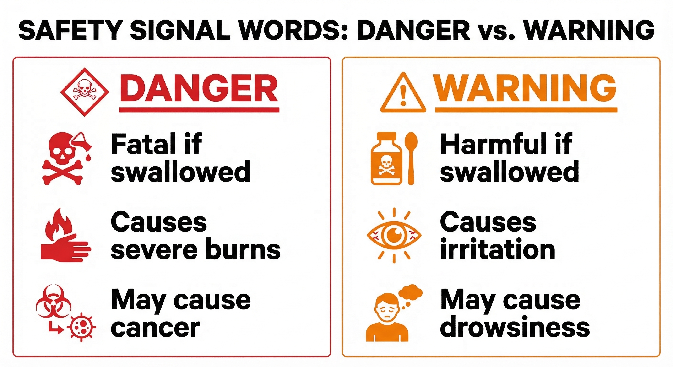
Lecture
SLIDE 12 / 14
Common Pitfalls in Compliance
1
Failure to update the waste register with new chemical types.
2
Using unauthorized carriers for transporting hazardous materials.
3
Mixing incompatible wastes leading to dangerous chemical reactions.
4
Neglecting to label containers with hazard symbols correctly.
5
Delaying the submission of annual returns to the Board.
6
Assuming all industrial waste is non-hazardous without testing.
7
Ignoring the requirement for emergency response plans.
Source: www.safetyevolution.com
Chandigarh University
12 / 14
Notes:
Common pitfalls include mixing incompatible wastes, which can cause explosions, or using unauthorized carriers. Many generators fail to update their registers when new chemicals are introduced. Assuming waste is safe without testing is a dangerous assumption that often leads to severe penalties.

Slide 13

Lecture
SLIDE 13 / 14
Key Takeaways
1
The 1989 Rules define hazardous waste by specific chemical properties.
2
Generators are liable for waste until final disposal is complete.
3
The manifest system ensures full traceability of hazardous materials.
4
Import is banned, and export requires strict CPCB consent.
5
Accurate waste calculation is essential for compliance and safety.
Source: www.slideteam.net
Chandigarh University
13 / 14
Notes:
To summarize, the Rules define hazardous waste by its properties and hold generators fully liable. The manifest system ensures traceability, while import bans protect our borders. Accurate calculation and strict adherence to these rules are the keys to sustainable engineering.

Slide 14
Lecture
SLIDE 14 / 14
References
ENVIRONMENTAL STUDIES
From Crisis to Cure — R. Rajagopalan
• Environmental Science and Engineering — Benny Joseph
• Environmental Studies — R.C. Sharma and D. Gurbir Sangha
• Introduction to Environmental Science — Anjaneyulu, Y.
• Environmental Pollution Control Engineering — C.S. Rao
• Textbook of Environmental Studies for undergraduate courses — E. Bharucha
• Environmental Science — S.C. Santra
Chandigarh University
14 / 14
Notes:
These seven textbooks provide the foundational knowledge for understanding environmental laws and engineering controls. I encourage you to consult Benny Joseph and R.C. Sharma for detailed case studies on hazardous waste management. These resources will support your future work in sustainable development.

